Slide 1
Abstract algebra ch 11 fundamental theorem of finite abelian groups

Slide 2
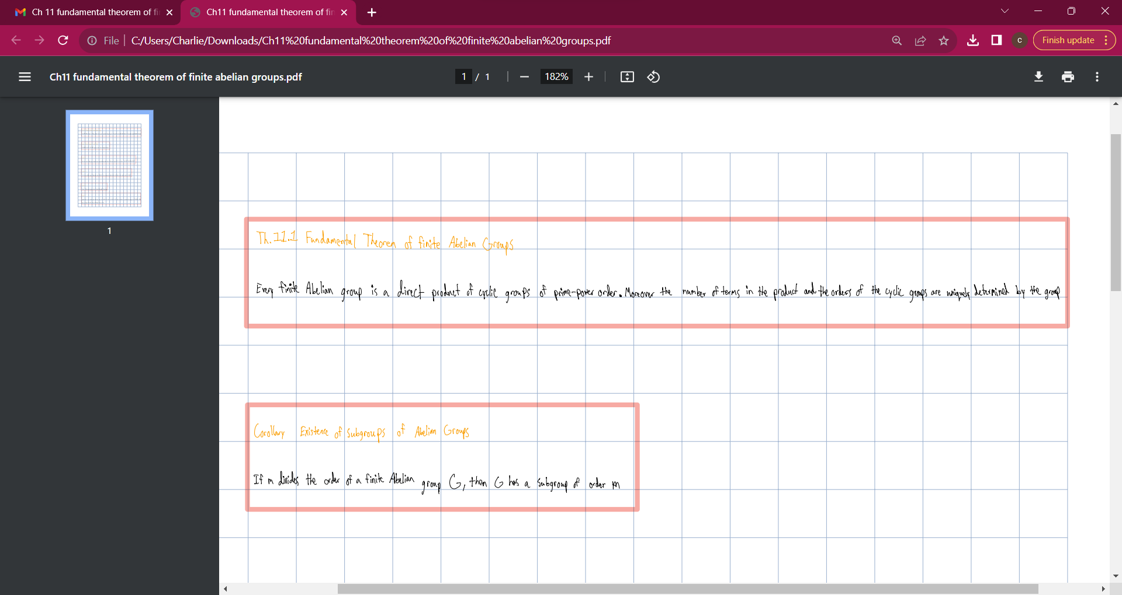

Slide 3
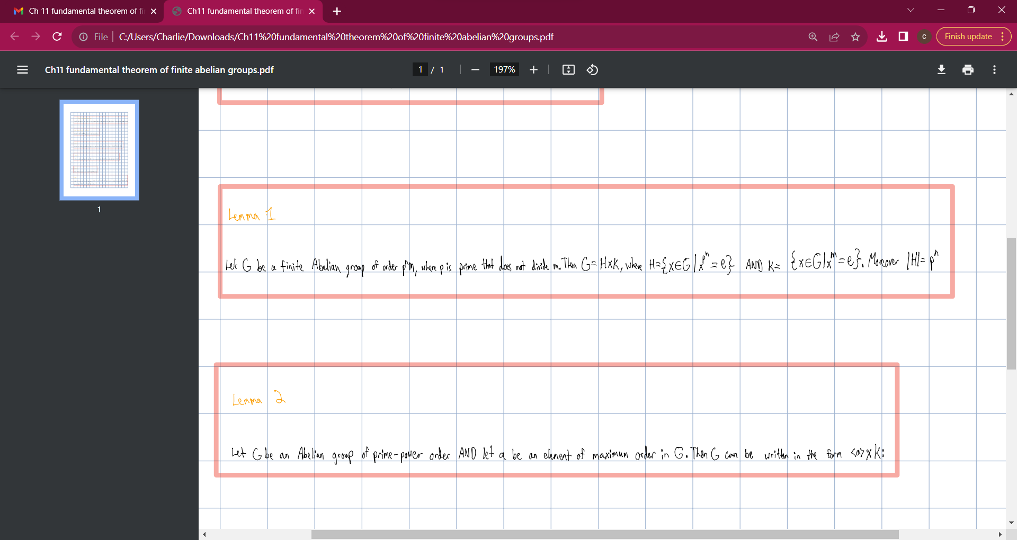

Slide 4
